Slide 1
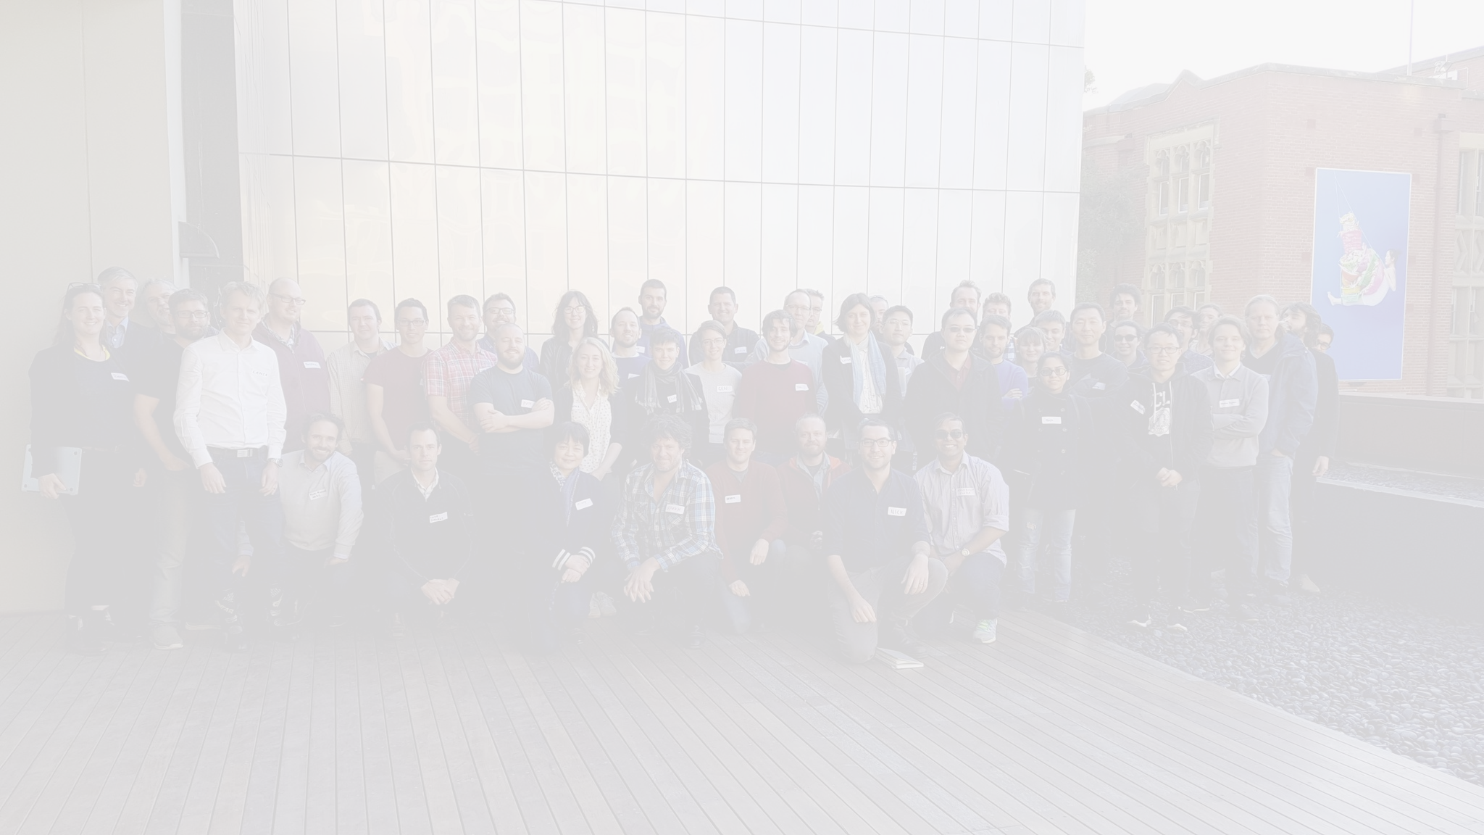







RSE Asia Australia Unconference
Silos to Synergy - Achieving collaboration across domains
13th to 15th September 2023
Key Partner
Allied Partners

Slide 2
Slide Title
Slide information
RSE Asia Australia 2023
Silos to synergy
13th to 15th September

